Slide 1
Final Project: Recommendation Systems
Benedikt Roth 20.02.21

Slide 2
Agenda
Example of recommendation systems
Question to answer in this project
Types of recommendation systems
Solution
Conclusion

Slide 3
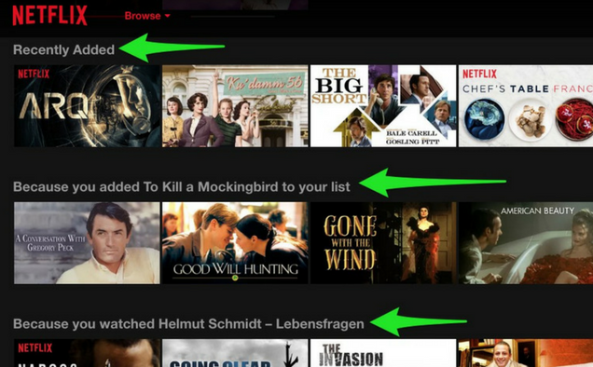
Netflix

Slide 4
Questions to answer in this project
Is machine Learning the best apporach to build a recommendation system on?

Slide 5
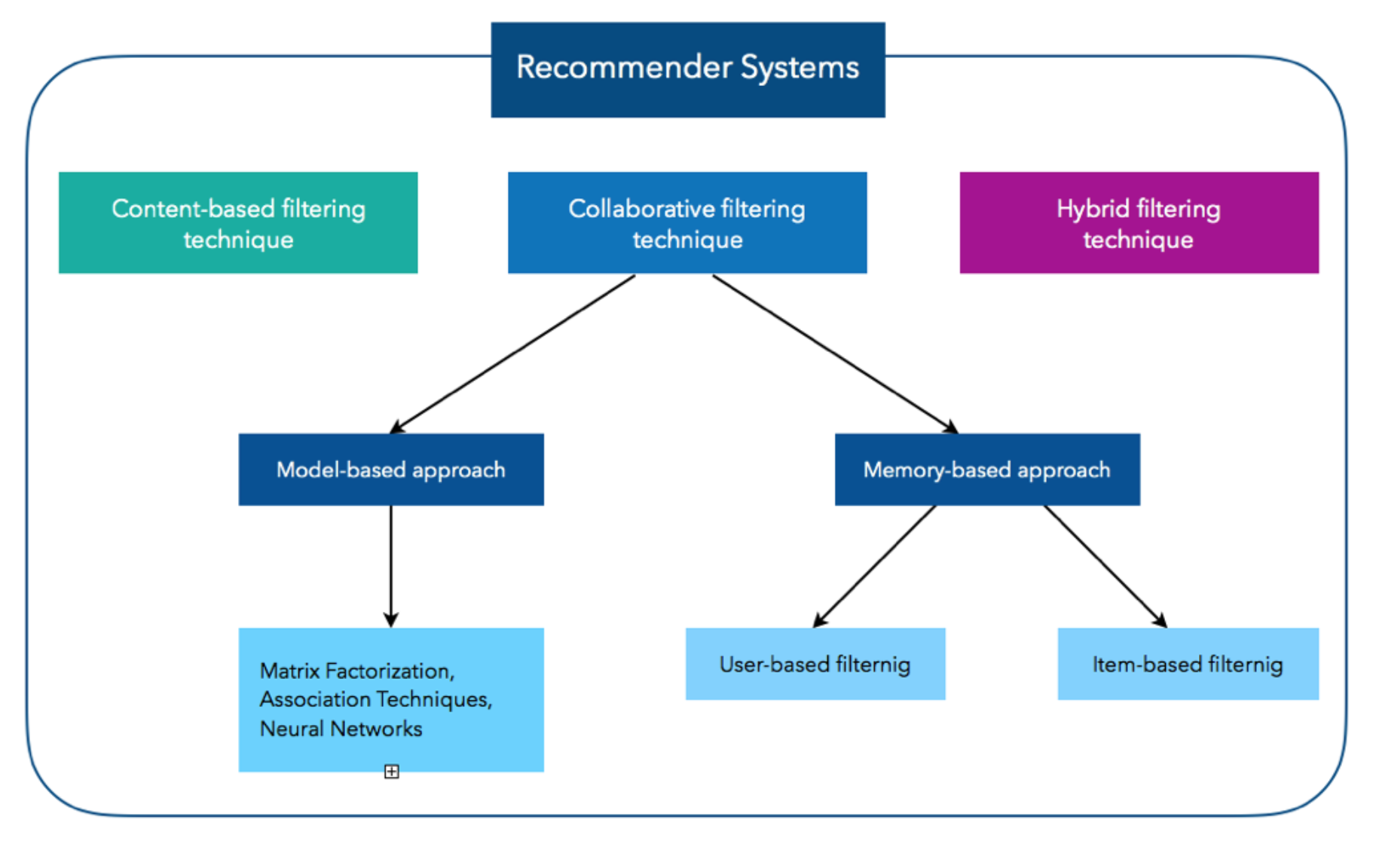
Types of recommendation systems
Content Based Filtering
Memory Based Collaborative Filtering
User-Item Collaborative Filtering
Item-Item Collaborative Filtering
Model Based Collaborative Filtering

Slide 6
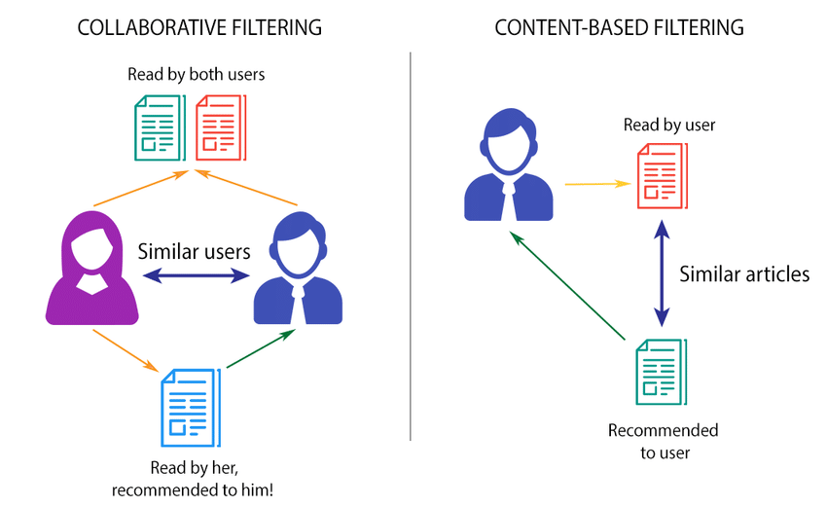
Content based filtering vs. Collaborative filtering

Slide 7
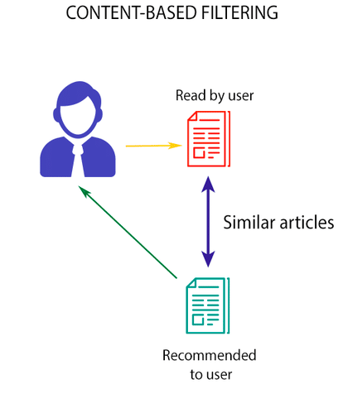
Content Based Filtering
Search for similar content
Recommend items based on the content a user has rated highly in the past Advantage:
Able to recommend users with unique taste
No need for data on other users
Disadvantage:
Unable to use quality judgment

Slide 8
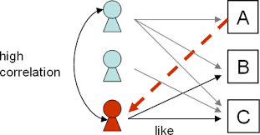
Collaborative Filtering: User Based
Search for User-User correlations
Recommend Items preferred by those users Advantage:
No knowledge about item features needed
Disadvantages:
Problems with new Users
Problems with new Items
Problem when many items and therefore a lot of unrated ones

Slide 9
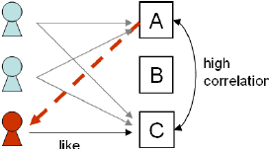
Collaborative Filtering: Item Based
Search for item-item correlations
Recommend Items with highest correlation Advantage:
No knowledge about item features needed
Better scalable because of correlations between limited number of items instead of very large number of users
Disadvantages:
Problems with new Users
Problems with new Items

Slide 10
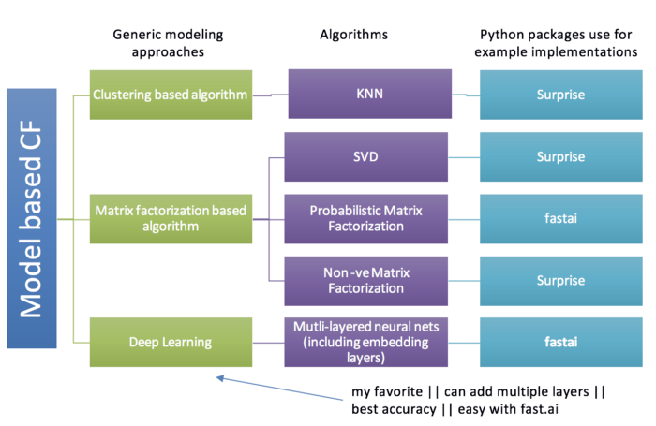
Collaborative Filtering: Model Based
Search for item-item correlations
Recommend Items with highest correlation Advantage:
Dimensionality reduction
Missing values become less important
Disadvantages:
Inference is intractable because of hidden factors

Slide 11

Solution
Movie Dataset
UserId | MovieId | Title | Genre | Rating | Time
345 | 1 | Toy Story (1995) | Animation | 4 | 1997
567 | 205 | Shrek the Third (2007) | Anmiaton | 5 | 2013
... | ... | ... | .... | ... | ...
Unique Users: 668 Unique Movie: 10325
Recommendation Systems

Slide 12

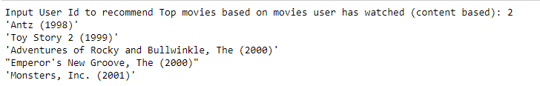
Solution
Recommendation Systems
Item-Item Collaborative Filtering
Content Based Filtering
User-Item Collaborative Filtering
Matrix Factorization (OWN)
Matrix Factorization (ML)
Output:

Slide 13
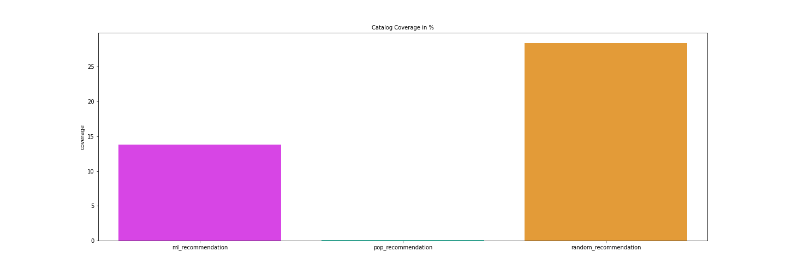
Answer

Slide 14
Conclusion
Machine Learning approach using Surprise Package creates a recommendation system which is not always the best. My analysis shows that it is not even better than a recommendation system just based on popularity
Using different methods might increase quality of model based recommendation systems
Using Deep Learning(Fastai Package) for further improvement
There are several ways to improve recommendation systems by using larger datasets with more data points and more features but also this increases complexity

Slide 15
Thank You

